Slide 1
Lesson 5: Wired and wireless transmission media
Mack 2023
Notes:
Last updated 30-11-2021
Resources are updated regularly — the latest version is available at: ncce.io/tcc.
This resource is licensed under the Open Government Licence, version 3. For more information on this licence, see ncce.io/ogl.

Slide 2
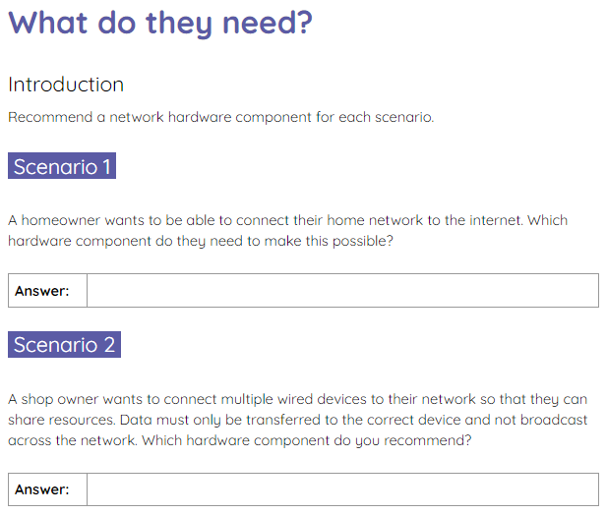
What do they need?
Starter activity
Use the activity sheet to decide which network hardware component is required for each scenario.
If you can, attempt the explorer task.

Slide 3
What do they need? Solutions
Starter activity
Scenario 1 .
A homeowner wants to be able to connect their home network to the internet. Which hardware component do they need to make this possible?
Router

Slide 4
What do they need? Solutions
Starter activity
Scenario 2 .
A shop owner wants to connect multiple wired devices to their network so that they can share resources. Data must only be transferred to the correct device and not broadcast across the network. Which hardware component do you recommend?
Switch

Slide 5
What do they need? Solutions
Starter activity
Explorer task .
Describe the role and function of a wireless access point (WAP).
A wireless access point connects to a wired network and provides a wireless network radio signal for wireless devices to connect to. The WAP provides wireless access to the network.

Slide 6

Lesson 5: Wired and wireless transmission media
Objectives
In this lesson, you will:
Define a wired and a wireless network
Define transmission media
Describe the attributes of fibre optic and copper cables used in wired networks
Describe Bluetooth as a mode of connection
Discuss the advantages and disadvantages of wireless networks compared to wired networks

Slide 7

Recap
Activity 1
In this unit you have explored:
Types of networks (PAN, LAN, WAN)
The peer-to-peer and client–server models
Network hardware components (hub, switch, etc.)
Network topologies (how networks can be arranged)

Slide 8

Transmission media
Activity 1
You are now going to take a look at the media used to transmit data from one device to another.
This is called transmission media and fits into two main categories:
Wired
Wireless
Wired transmission media

Slide 9
Wired transmission media
Activity 1
Wired transmission media is a physical cable that connects one device to another.
This is often shown as a solid or a long dashed line in a graph or a diagram.

Slide 10

Wireless transmission media
Activity 1
Wireless transmission media doesn’t require a physical cable. Wireless signals are sent through the air.
A wireless connection is often shown using a short dotted line or a wave symbol.
Notes:
Wireless symbol source: https://pixabay.com/vectors/wireless-signal-icon-image-vector-1119306/

Slide 11
Wired and wireless networks (think, write, pair, share)
Activity 1
List any examples of wired or wireless networks that you might have seen in your day-to-day lives?

Slide 12
Wired and wireless networks (think, write, pair, share)
Activity 1
List any examples of wired or wireless networks that you might have seen in your day-to-day lives?
Free WiFi on public transport
The school network
Supermarket check out system
Touch screen ordering system for fast food
Home wireless network

Slide 13




Wired and wireless
Activity 1
A network can be made up of both wired and wireless transmission media.
For example, a school might use a wired connection in a computer room that uses desktop computers that aren’t designed to move around.
The school might also have a wireless access point for a teacher to connect portable devices to for marking work or calling the register.
Notes:
Image source: https://pixabay.com/vectors/tablet-ipad-homebutton-app-1717178/ (tablet with black screen)
Image source: https://pixabay.com/vectors/board-pc-screen-vector-background-1362851/ (tablet with grey screen)
Image source: https://pixabay.com/vectors/laptop-computer-business-technology-312499/ (laptop)

Slide 14
Transmission media
Activity 1
Transmission media is the media used to transmit data.
In computing, data in its simplest form is 0s and 1s.
The signals used to transmit the 0s and 1s vary depending on the type of transmission media being used.

Slide 15
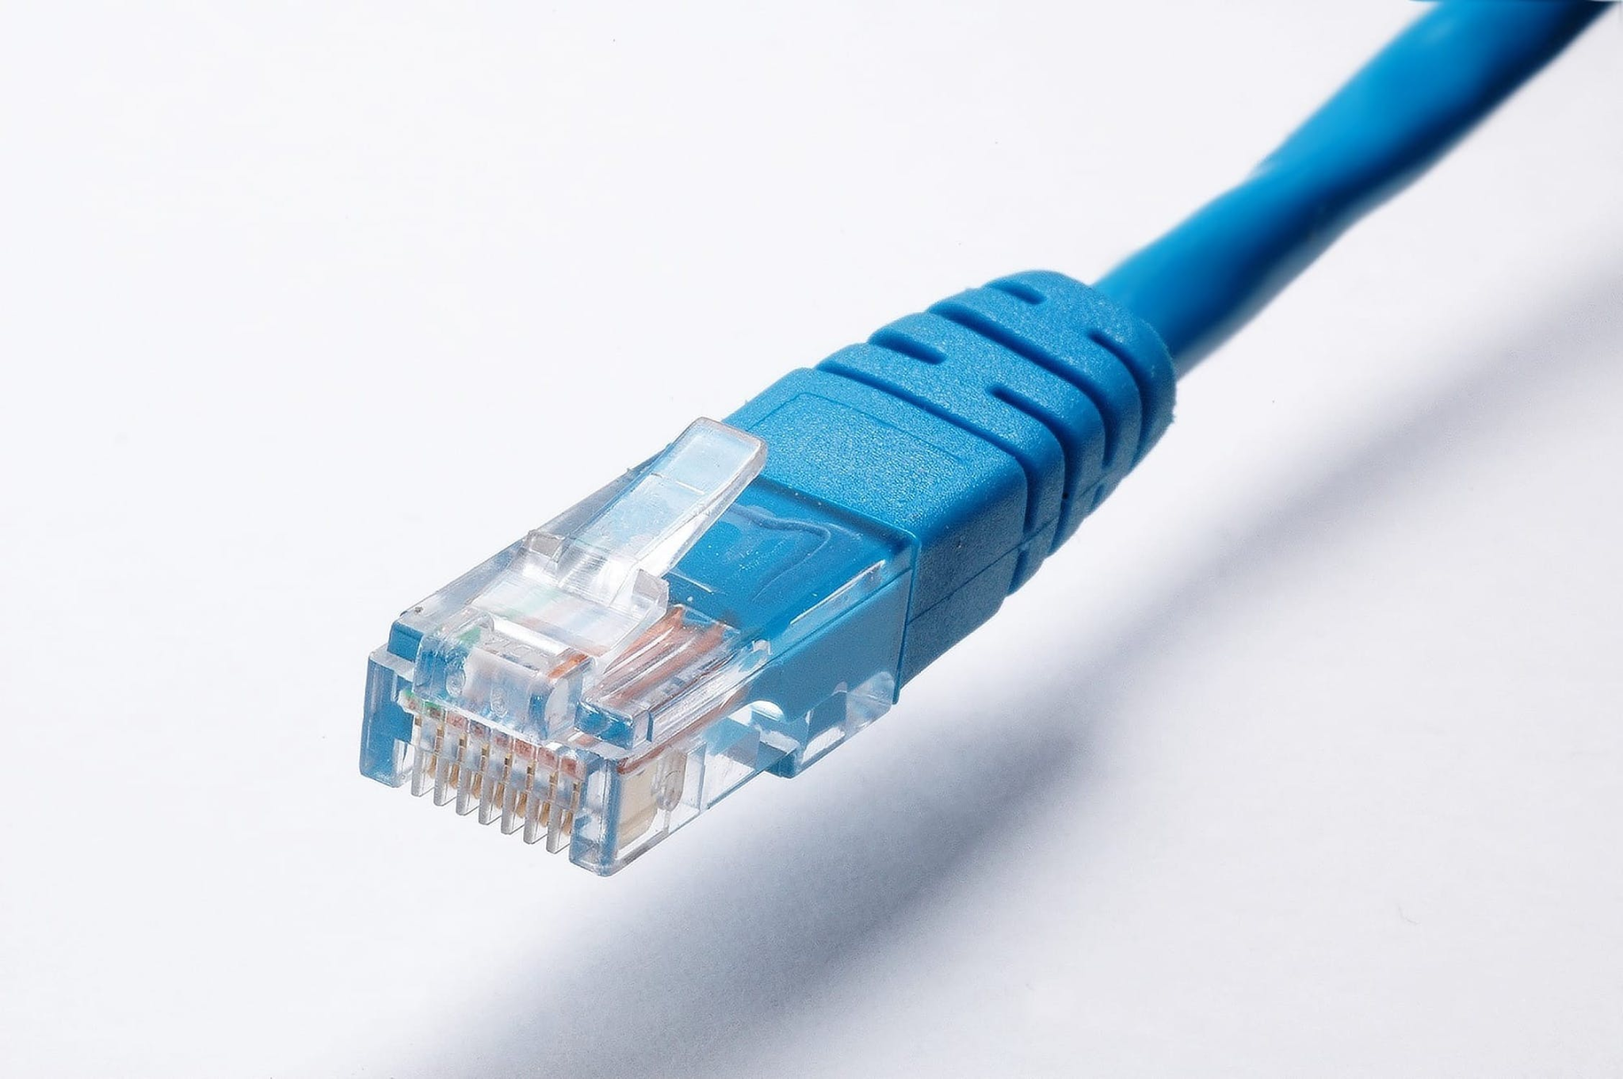
Copper cable
Activity 1
Copper cable is a type of wired transmission media. It uses electrical signals to transmit data.
A 1 is represented by a voltage of 3.3 or 5V.
A 0 is represented by a voltage of 0V.
Notes:
Image source: https://www.pexels.com/photo/cable-connection-connector-cord-415043/

Slide 16
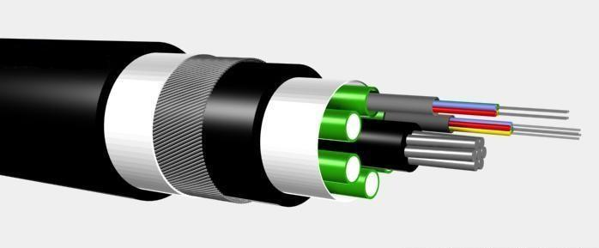
Fibre optic cable
Activity 1
Fibre optic cable is a type of wired transmission media. It uses light pulses as signals to transmit data.
A 1 is represented by the light being on.
A 0 is represented by the light being off.
Notes:
Image source: https://commons.wikimedia.org/wiki/File:Optical_fiber_cable.jpg

Slide 17


WiFi
Activity 1
WiFi is a suite of protocols used for wireless transmission. It uses radio frequencies to send signals.
Changes in the radio frequency signify a 1 or a 0.
WiFi signals can transmit data up to 50 metres.
You will learn more about protocols in a future lesson.
Notes:
Image source: https://pixabay.com/vectors/wifi-access-internet-logo-network-158401/

Slide 18

Bluetooth
Activity 1
Bluetooth is another form of wireless transmission media. It also uses radio frequencies to transmit data.
Bluetooth signals can transmit data up to 10 metres.
Notes:
Image source: https://pixabay.com/vectors/bluetooth-icon-bluetooth-logo-670069/

Slide 19
How are signals transmitted? (pause and think)
Activity 1
Copper cable
Radio frequencies
Fibre optic
Electrical signals
WiFi and Bluetooth
Light pulses

Slide 20
How are signals transmitted?
Activity 1
Copper cable
Radio frequencies
Fibre optic
Electrical signals
WiFi and Bluetooth
Light pulses

Slide 21
How are signals transmitted?
Activity 1
Copper cable
Radio frequencies
Fibre optic
Electrical signals
WiFi and Bluetooth
Light pulses

Slide 22
How are signals transmitted?
Activity 1
Copper cable
Radio frequencies
Fibre optic
Electrical signals
WiFi and Bluetooth
Light pulses

Slide 23
How are signals transmitted?
Activity 1
Copper cable
Radio frequencies
Fibre optic
Electrical signals
WiFi and Bluetooth
Light pulses

Slide 24
How are signals transmitted?
Activity 1
Copper cable
Radio frequencies
Fibre optic
Electrical signals
WiFi and Bluetooth
Light pulses

Slide 25
How are signals transmitted?
Activity 1
Copper cable
Radio frequencies
Fibre optic
Electrical signals
WiFi and Bluetooth
Light pulses

Slide 26
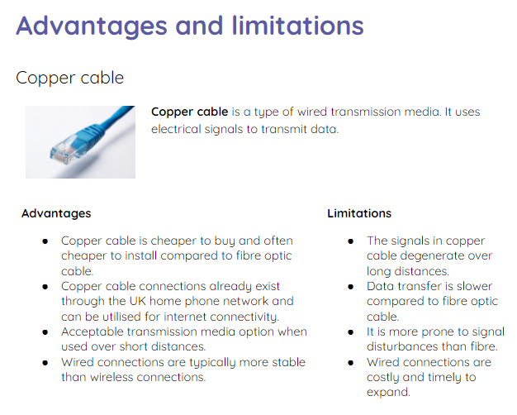
Advantages and limitations
Activity 2
The activity 2 sheet lists the advantages and limitations of each type of transmission media.
Read these carefully and decide which type of media is suitable for each scenario given.

Slide 27
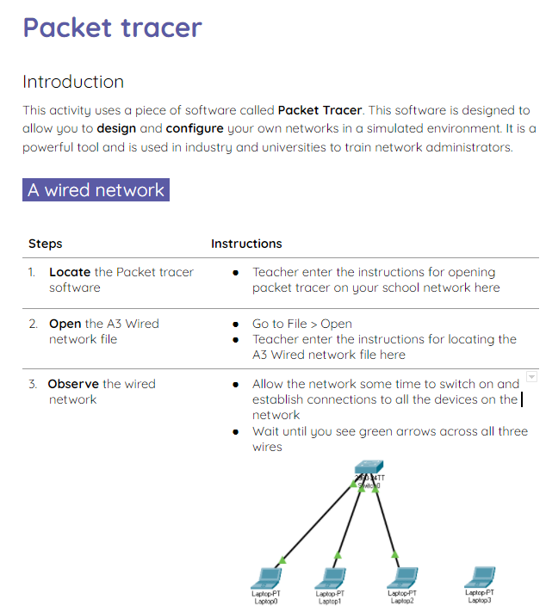
Packet tracer
Activity 3
Use the activity 3 sheet to learn how to add a wired and a wireless device to a network.
A further activity is also available on a separate worksheet, which will allow you to extend your network.

Slide 28

Wired vs wireless (think, write, pair, share)
Wrap Up
Using what you have learnt in today’s lesson, compare a wired and a wireless network.
Spend some time thinking about this on your own, then discuss it with a partner. Be prepared to share your answers with the class.
Notes:
Image source: https://pixabay.com/illustrations/balance-swing-equality-measurement-2108024/

Slide 29
Wired vs wireless: suggested solutions
Wrap Up
Wired connections are more stable than wireless.
Wireless connections are great for networks where mobility is required.
Wireless connections are quicker to install, once you have the wireless access point set up correctly.
Wired connections take longer to install and can cost more money.
The more connections to a wireless networks, the slower the network performance.
Wired connections are great for devices that are going to stay in the same place.

Slide 30
Next lesson
Summary
In this lesson, you…
Learnt about the different types of transmission media
Used Packet Tracer to add devices to a network
Next lesson, you will…
Learn about network performance and routing costs

